Slide 1
Comma Rules
Why do we need them?

Slide 2
Because...

Slide 3
And...

Slide 4
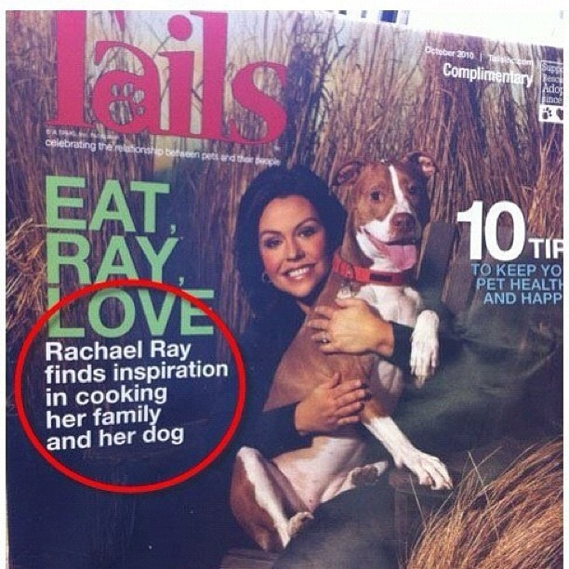
Still one more...

Slide 5
Rule # 1 Use commas to separate items in a list of three or more
Example
I need to buy eggs milk lettuce and bread.
I need to buy eggs, milk,lettuce and bread.

Slide 6
Rule # 2 Use a comma to separate independent clauses when they are joined by the following conjunctions. FOR – AND- NOR –BUT- OR – YET – SO (FANBOYS)
Example
I want to buy the new jacket but it is too expensive.
I want to buy the new jacket,but it is too expensive.

Slide 7
Rule # 3 Use a comma to separate a quotation from the rest of a sentence.
Example
“We need more sugar” she said “before it runs out.”
“We need more sugar,” she said,“before it runs out.”

Slide 8
Rule # 4 Use a comma to separate a dependent clause from an independent clause.
Example
When I get older, I will be able to drive. (Dependent),(Independent)
If you are good, I will buy you an apple. (Dependent), (Independent)

Slide 9
Rule # 5 Use a comma to separate appositives,a phrase not essential to the sentence.
Example
My brother a 26 year old male is watching TV.
My brother ,a 26 year old male ,is watching TV.

Slide 10
Rule # 6 Use a comma to separate an introductory element from the rest of the sentence.
Example
Hi how are you?
Hi,how are you?

Slide 11
WHITE BOARDS
3’s get dry erase boards for your table
2’s get markers and dry erasers for your table

Slide 12
PRACTICE
Rewrite the following sentences and place commas in the correct places within the sentence

Slide 13
Tanner my teacher is wearing a gray shirt.
Tanner, my teacher, is wearing a gray shirt.

Slide 14
Sorry we do not have enough room.
Sorry, we do not have enough room.

Slide 15
My favorite colors are blue red and pink.
My favorite colors are blue, red, and pink.

Slide 16
He said “We need to lower taxes!”
He said, “We need to lower taxes!”

Slide 17
They like chocolate but they like vanilla better.
They like chocolate, but they like vanilla better.

Slide 18
Carlos wants to visit Paris Italy Germany and China.
Carlos wants to visit Paris, Italy, Germany, and China.

Slide 19
When I get home I am going to brush my teeth.
When I get home, I am going to brush my teeth.

Slide 20
We can go to the zoo or we can go to the movie theater.
We can go to the zoo, or we can go to the movie theater.

Slide 21
In five minutes the building will be closed.
In five minutes, the building will be closed.

Slide 22
Yes I would like more water please.
Yes, I would like more water please.

Slide 23
Daniel Garrison a farmer wakes up very early.
Daniel Garrison,a farmer, wakes up very early.

Slide 24
“I am tired” he muttered.
“I am tired,” he muttered.

Slide 25
RETURN BOARDS
1’s return the dry erase boards
4’s return markers and erasers

